Slide 1
Numerical problem on decision tree using entropy and gain

Slide 2
ID3 Algorithm
1. Invented by J. Ross Quinlan
2. Employs a top-down greedy search through the space of possible decision trees.
3. Greedy because there is no backtracking. It picks the highest values first.
4. Select the attribute that is most useful for classifying examples (the attribute that has the highest Information Gain).

Slide 3
Steps
1. Find the entropy
*Entropy for the entire dataset
*Entropy for each attribute
2. Find information gain
The Formula for Entropy:
Entropy(S)= -P(yes)log2P(yes)-P(no)log2P(no)
The formula for information gain:

Slide 4
P(YES)=P(YES)/P(YES)+P(NO)
P(NO)=P(N0)/P(NO)+P(YES)

Slide 5
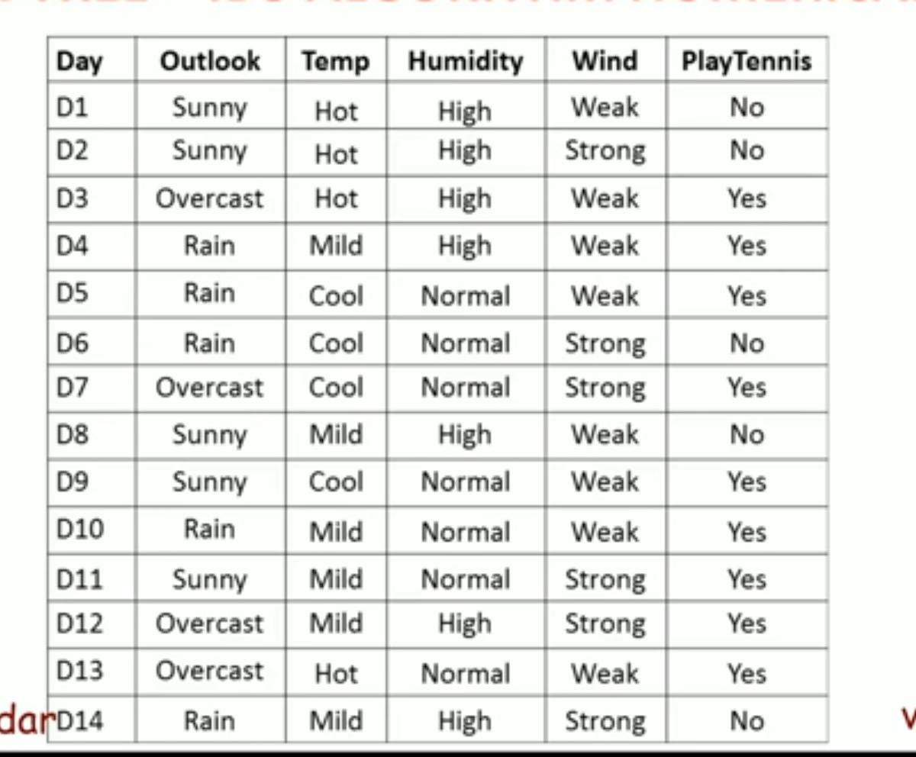

Slide 6
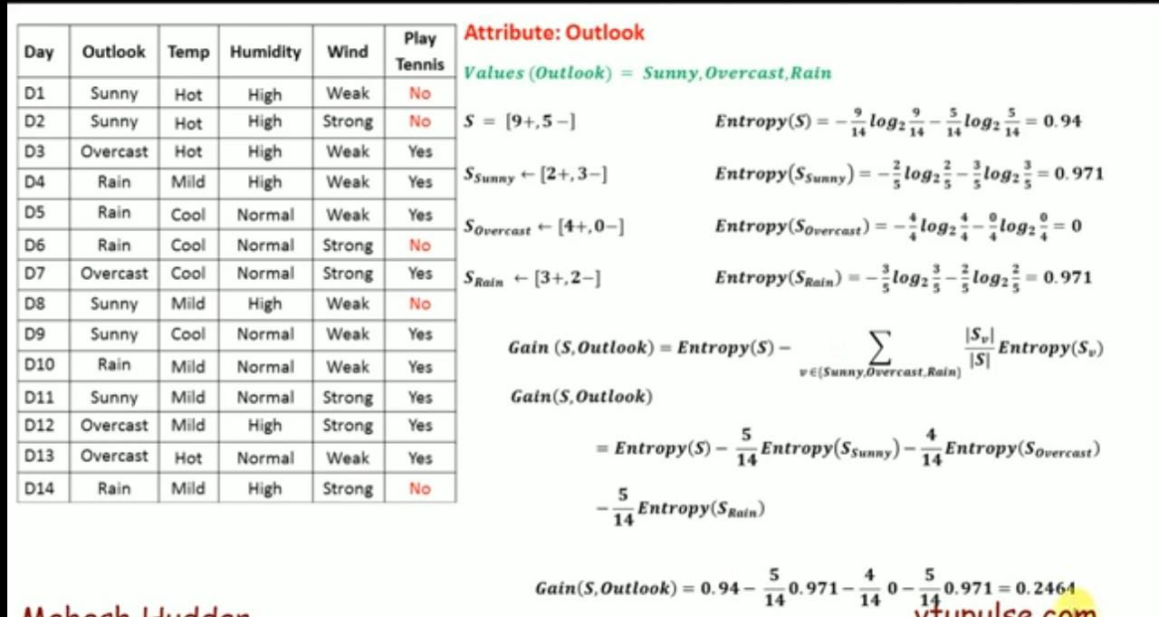

Slide 7
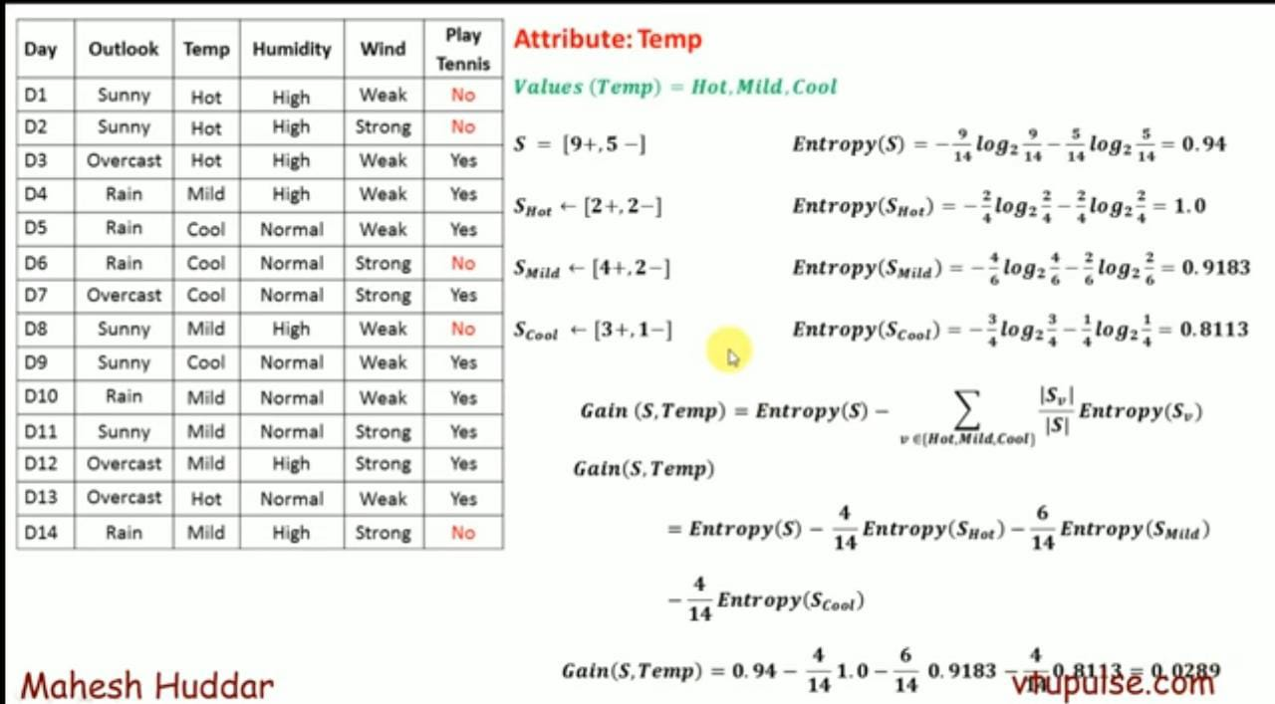

Slide 8
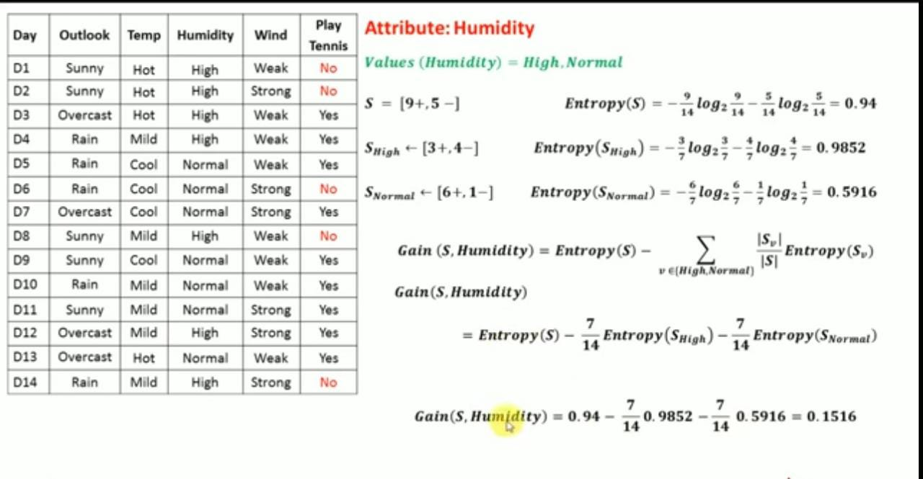

Slide 9
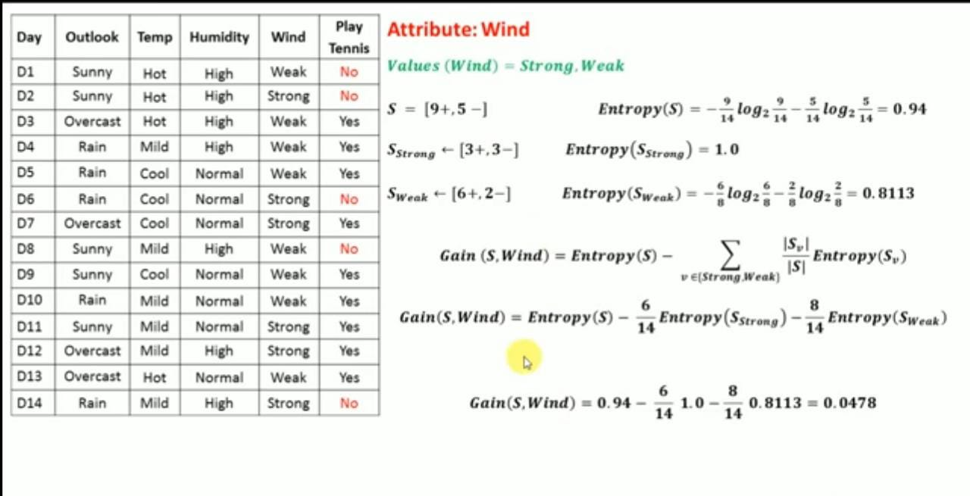

Slide 10
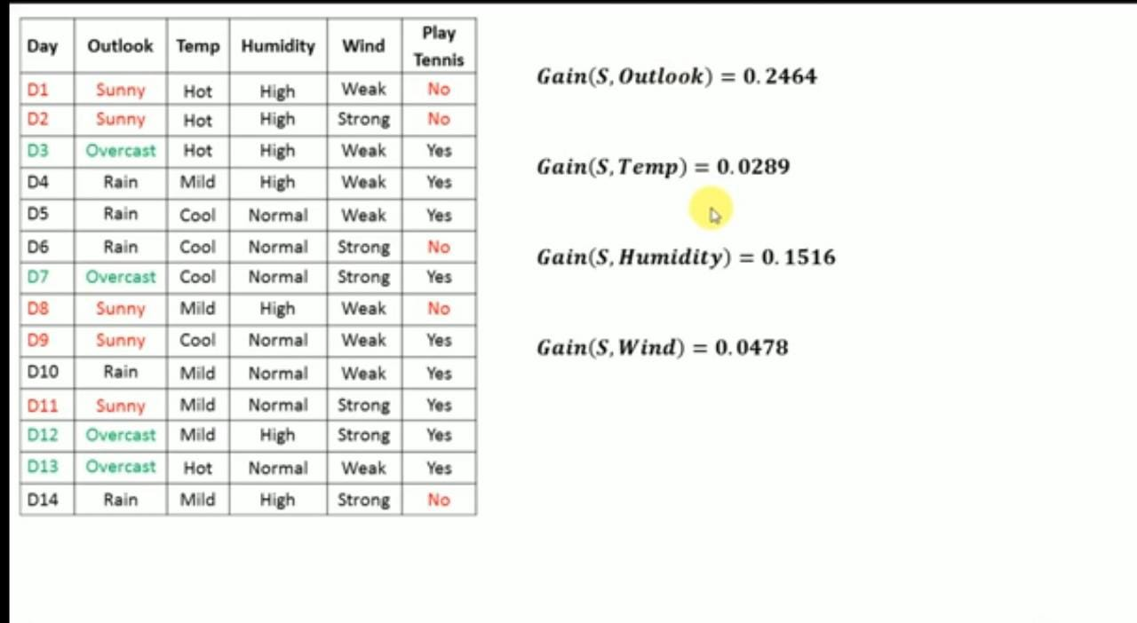
NOTE: As we can see gain is maximum for Outlook attribute so this will be consider as a root node

Slide 11
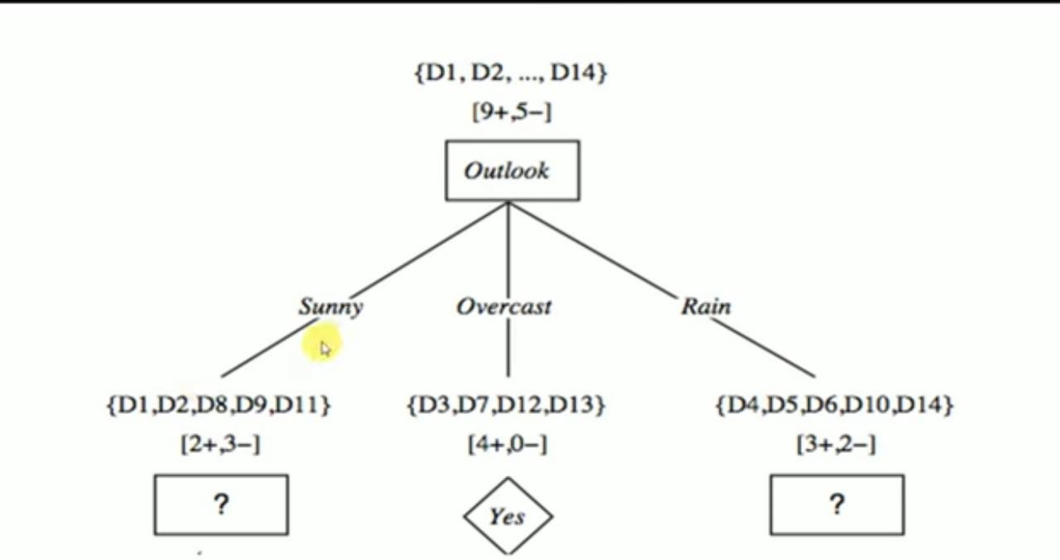

Slide 12
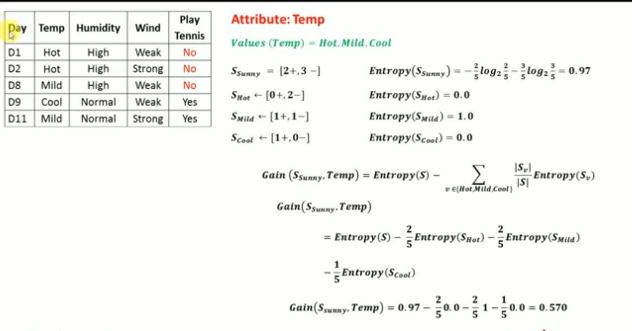

Slide 13
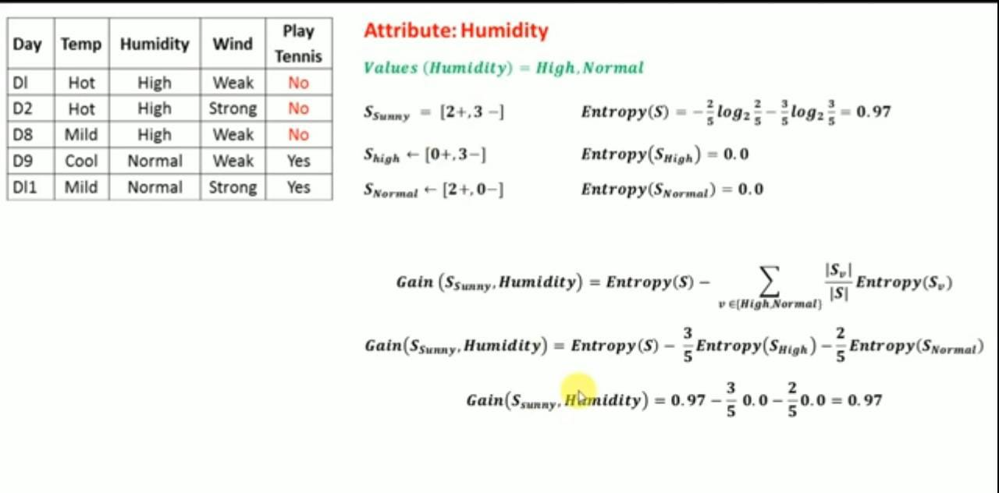

Slide 14
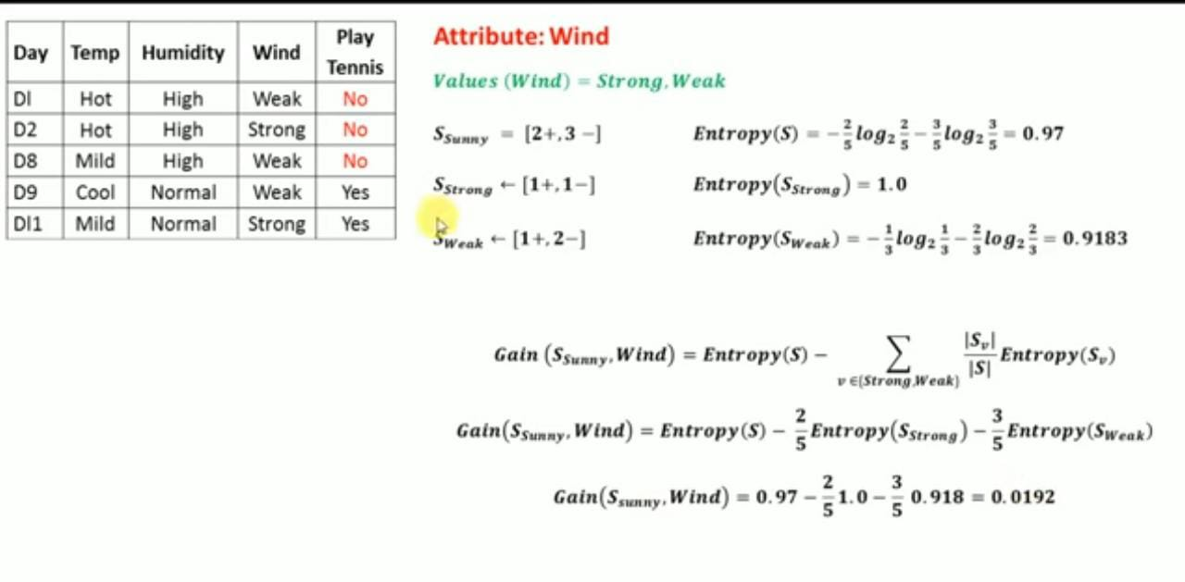

Slide 15
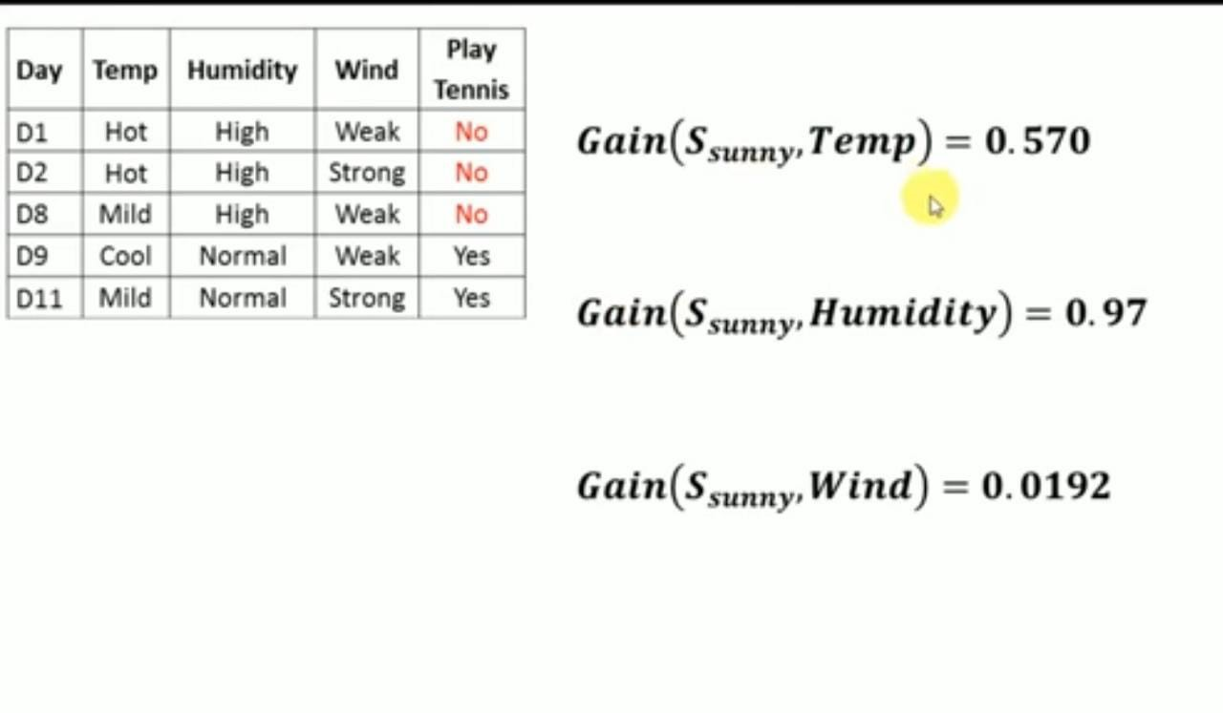

Slide 16
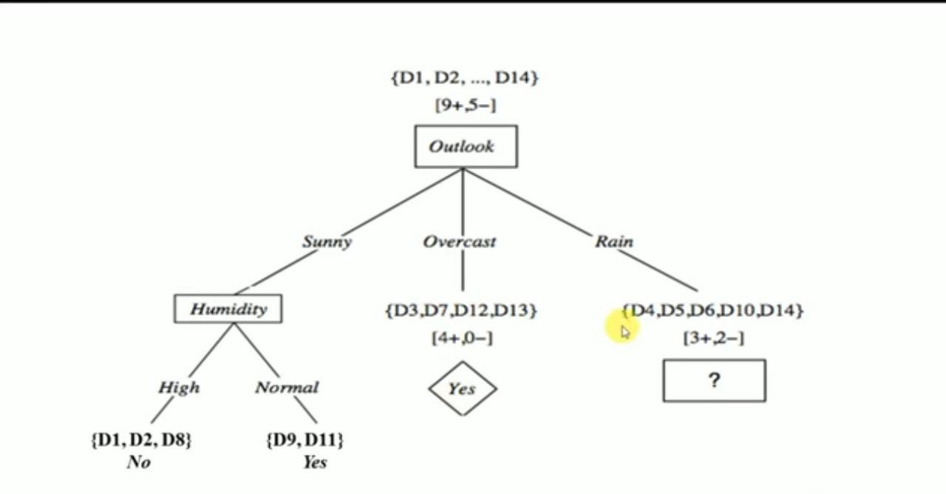

Slide 17
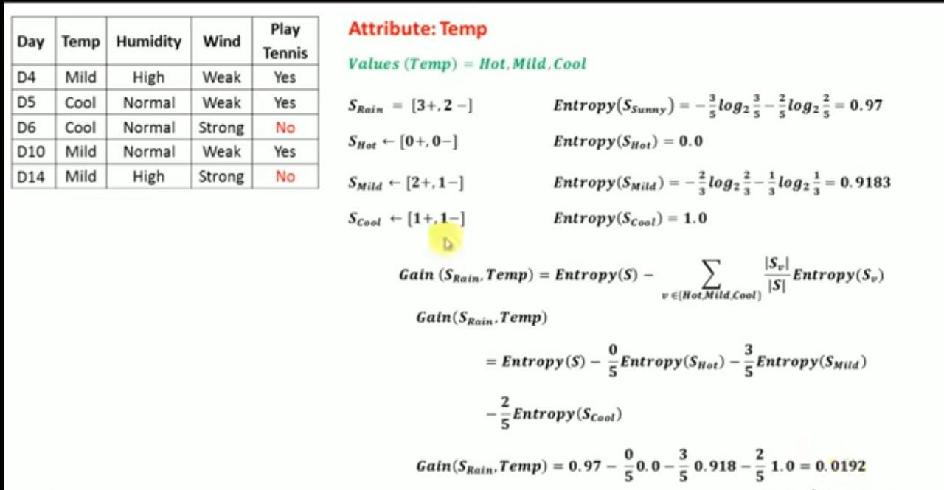

Slide 18
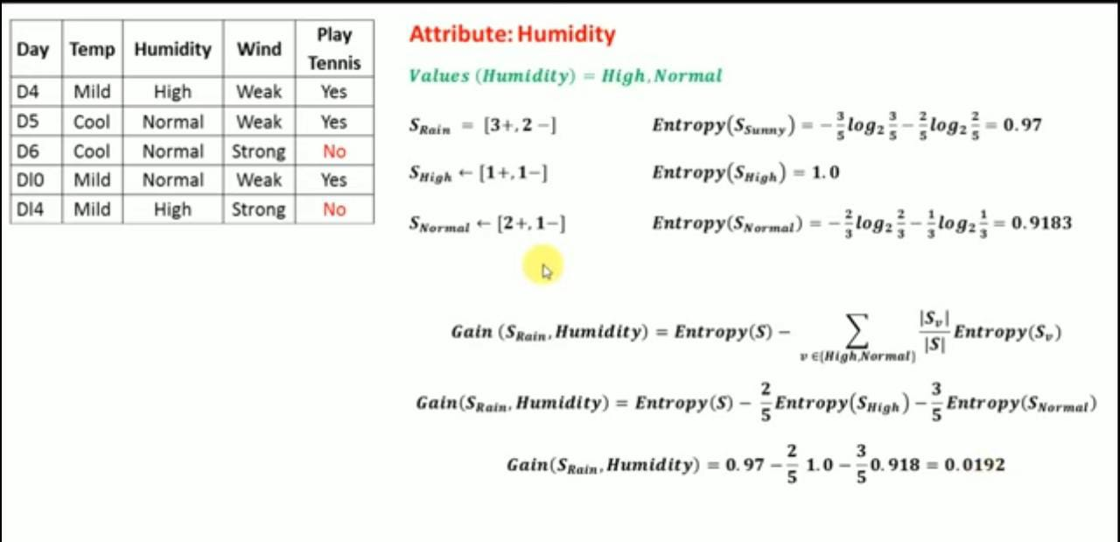

Slide 19
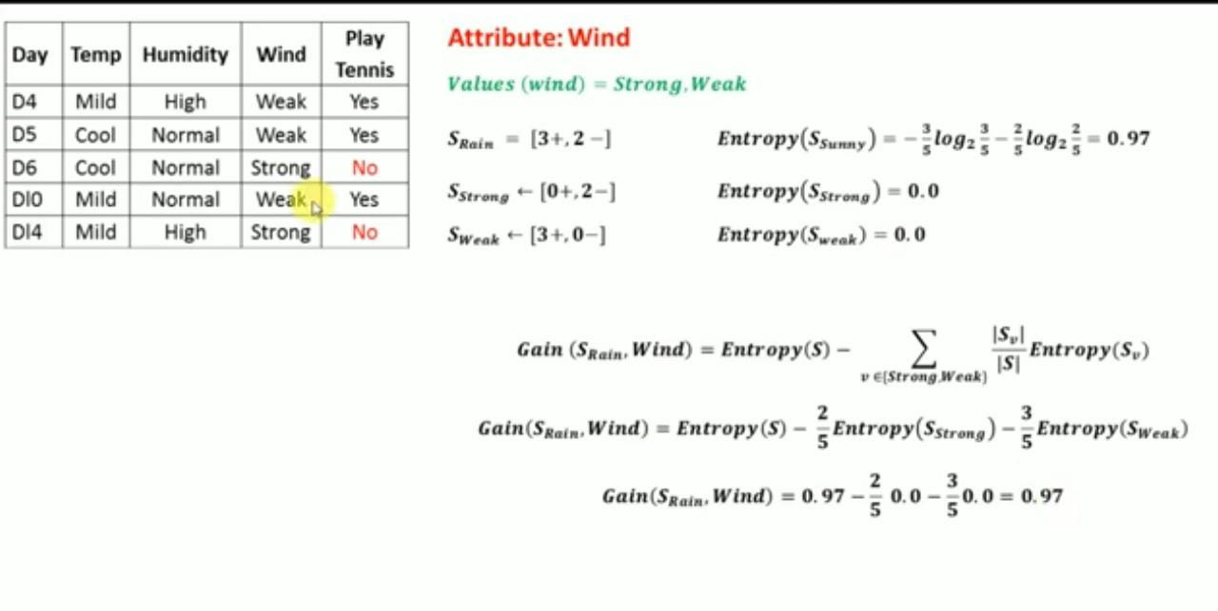

Slide 20
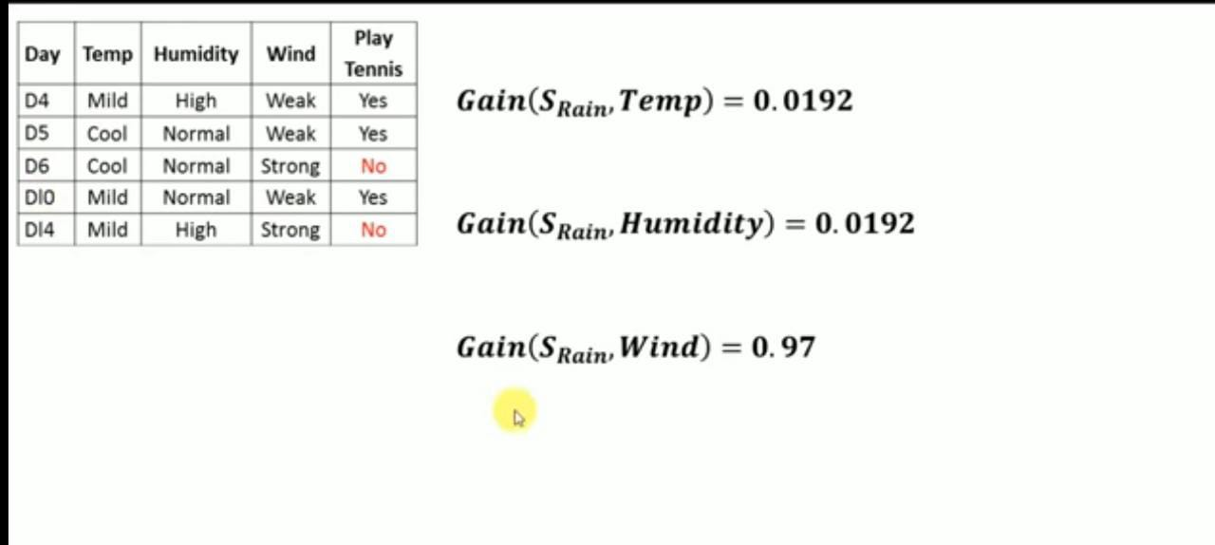

Slide 21
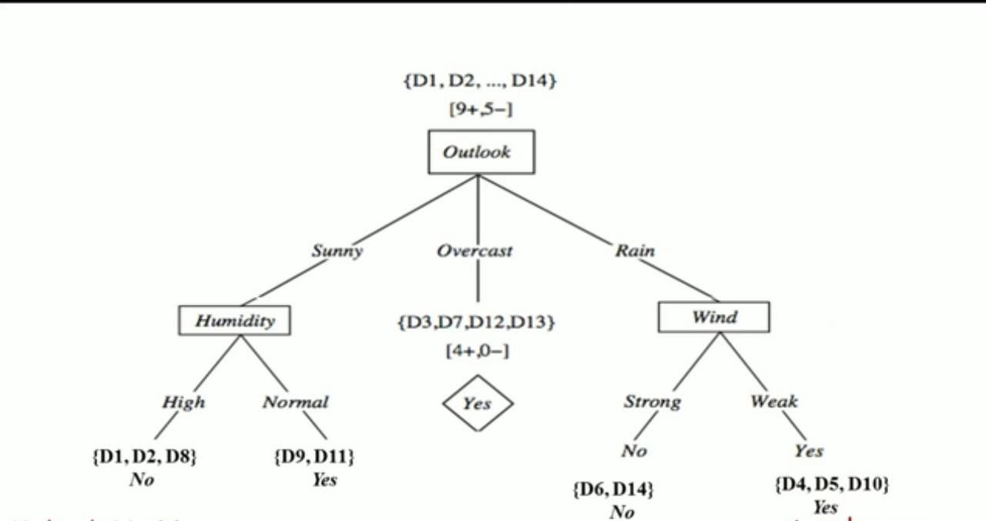

Slide 22
Numerical problem on decision tree using GINI INDEX

Slide 23


Steps
Find the Gini index for the entire dataset
Find the Gini index for each attribute
Formula for Gini index:

Slide 24
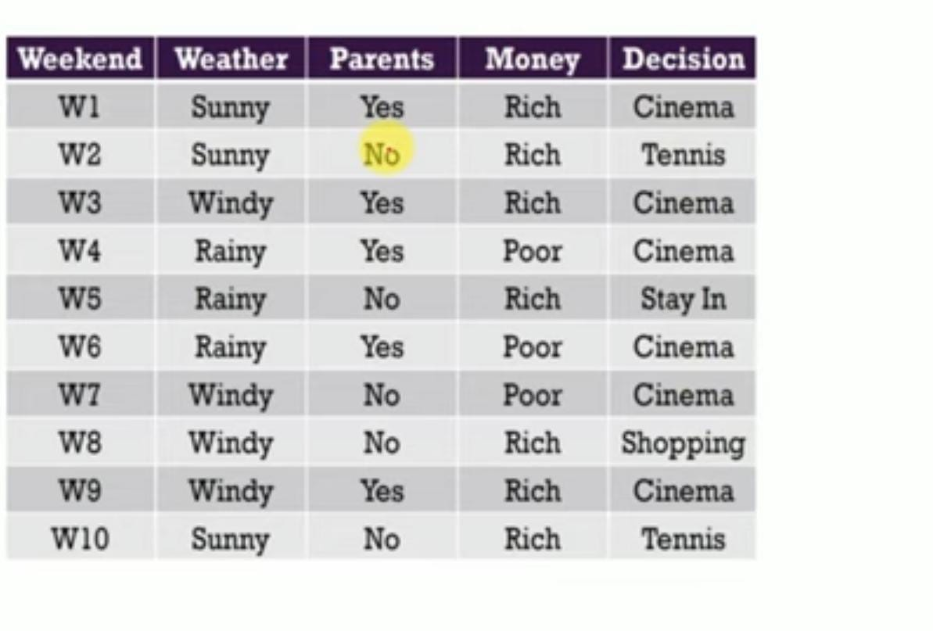

Slide 25
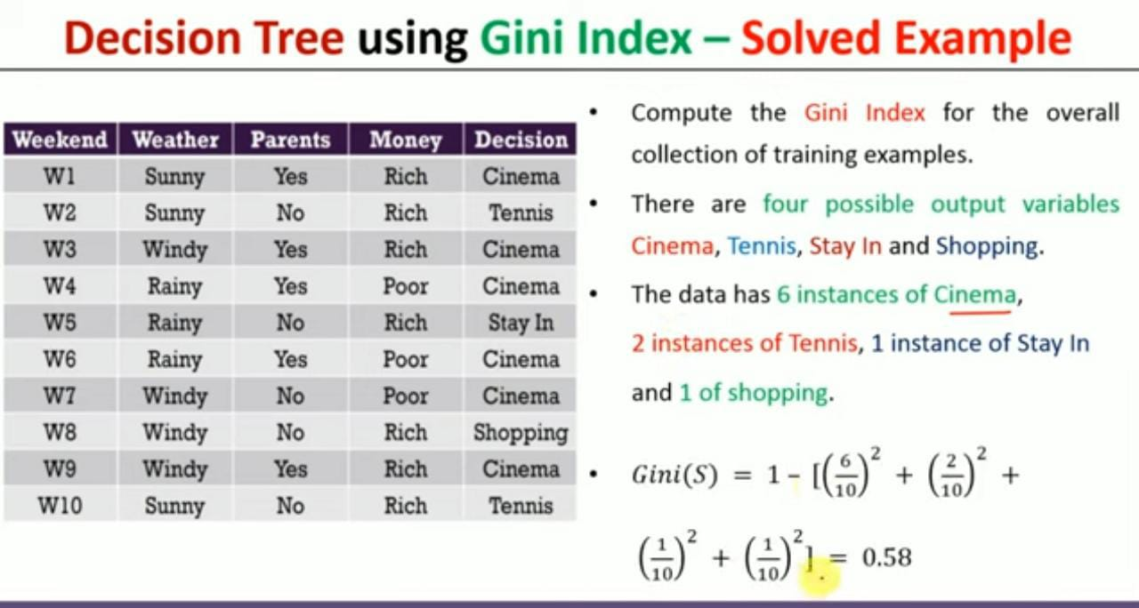

Slide 26
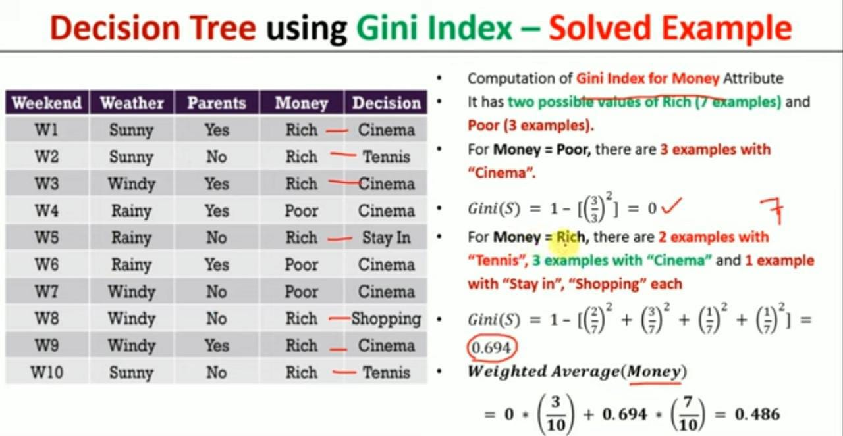

Slide 27
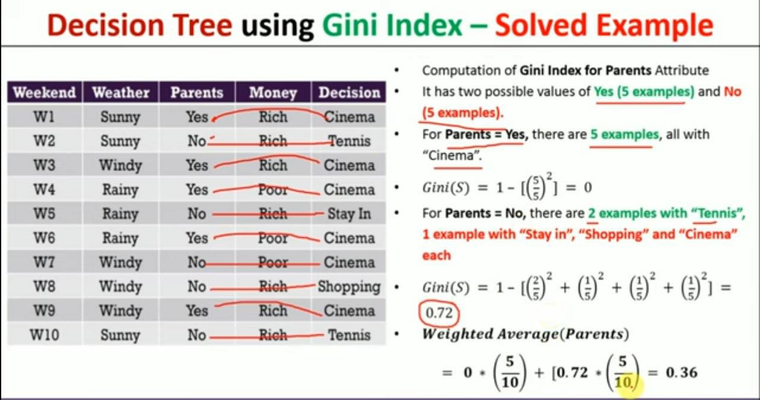

Slide 28
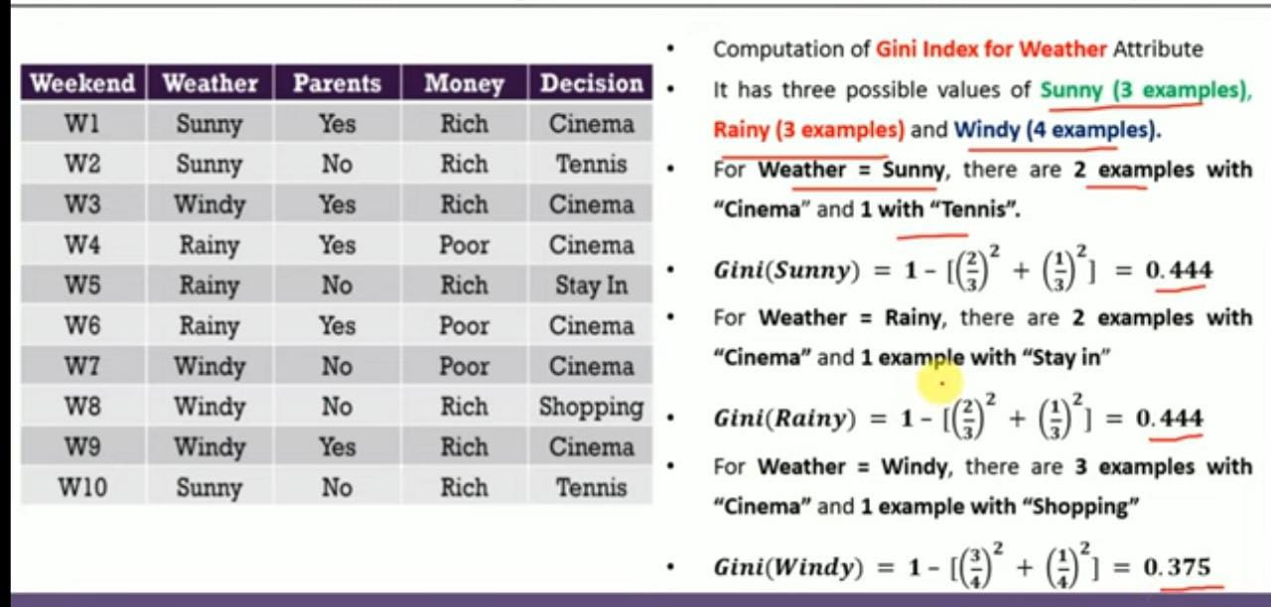

Slide 29
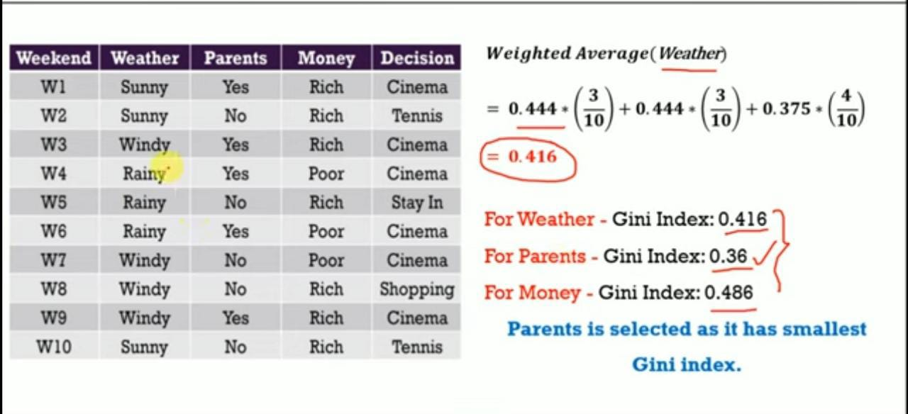

Slide 30
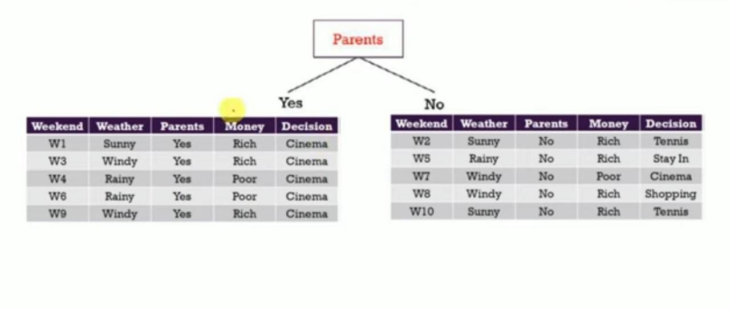

Slide 31
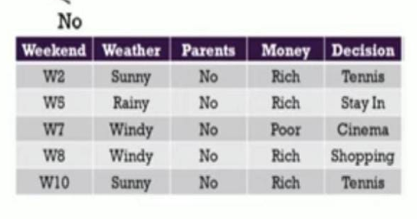
Parents
Yes
No
Cinema

Slide 32
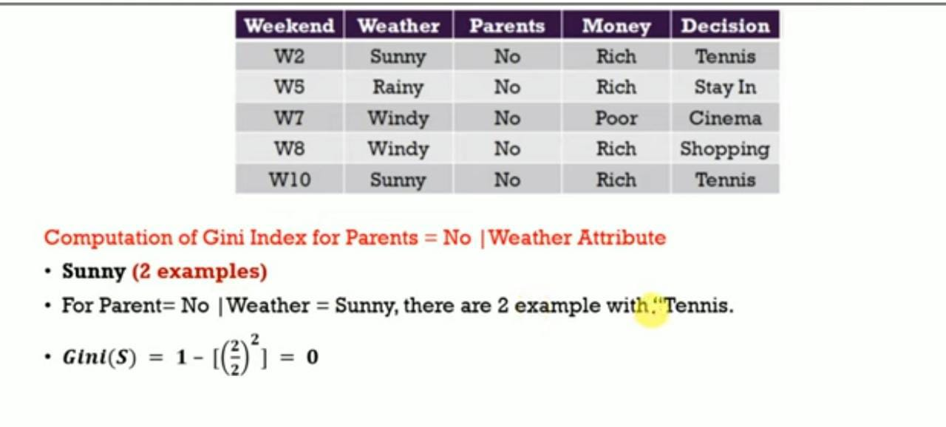

Slide 33
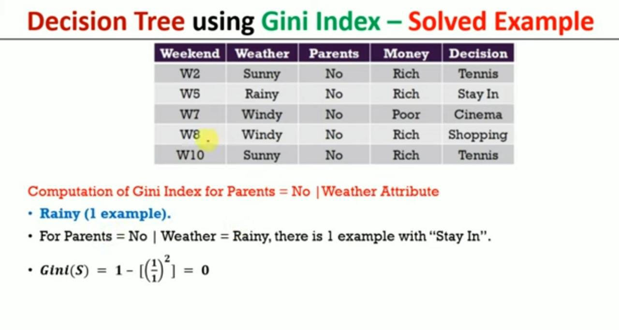

Slide 34
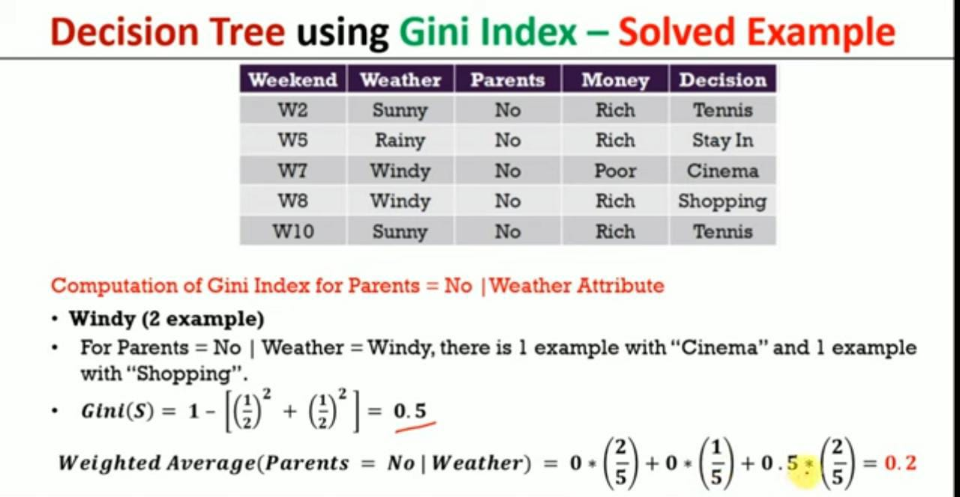

Slide 35
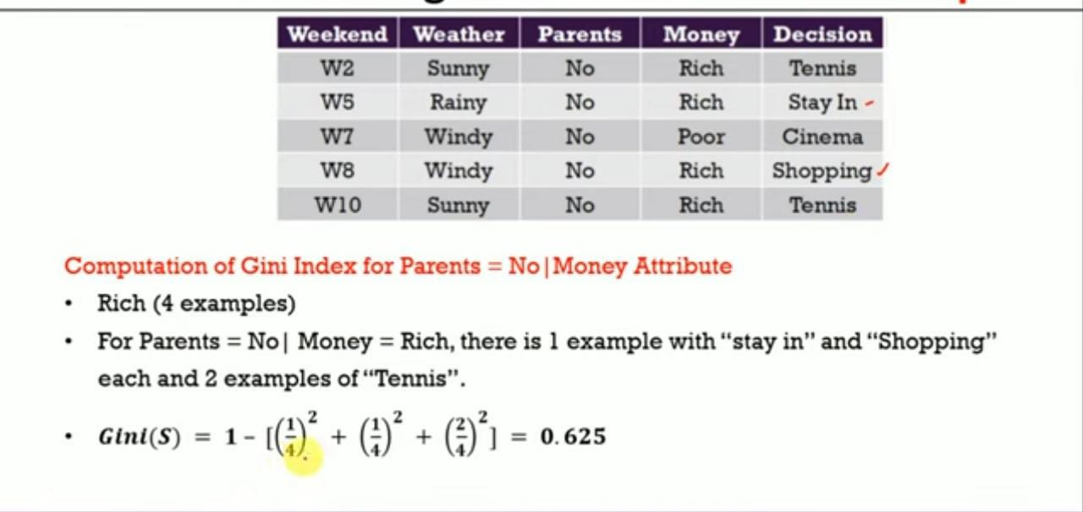

Slide 36
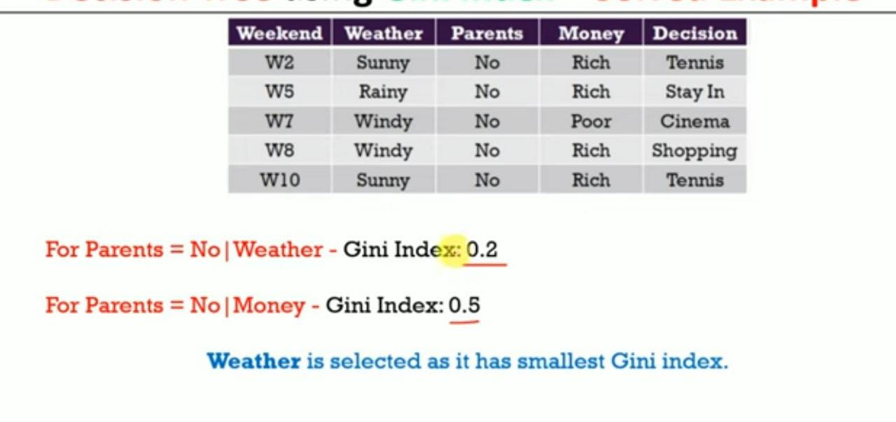

Slide 37
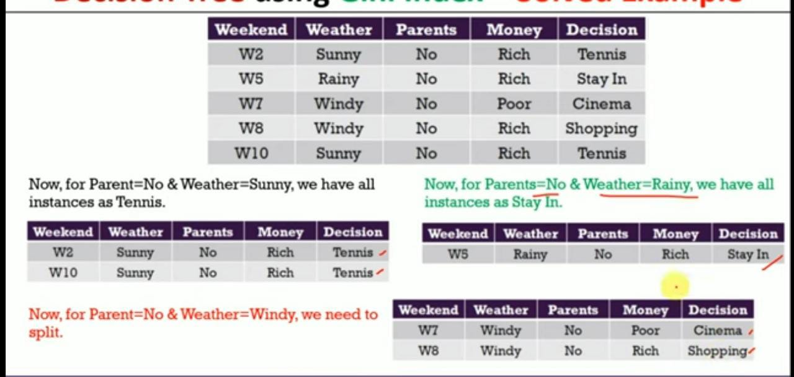

Slide 38
Parents
yes
no
Cinema
Weather
Windy
Rainy
Sunny
Money
Stay in
Tennis
Rich
Poor
Shopping
Cinema

